Slide 1
GAI 15670: TRANSACT
GBL-ISCM-SME

Slide 2
Overview of TRANSACT
Catherine, Himmat , Felix
11 Nov 2016

Slide 3
Transact is SME font end processing system. It is configured to serve as a single platform to manage following key functions in the processing of applications for Business Clients products (mainly Business Instalment Loans)
Workflow management from the point of origination up to account setup
Data captures and validations
Pre-screening and credit decision-making i.e. automated credit risk controls validation
Systems integration e.g. SM, Credit Bureau, Straight-through Processing/Online Account Opening, DeDup (CLAPS, Transact, eBBS) TH, ICM, eBBS, ICBS, RLS, PDW, SME CDW
There are 5 dev/test/regression VM servers maintained by project team and supported by India server team
Transact Business Criticality Level is 3 (Medium)
Transact can be built by both vendor (Experian) and in-house development team
Transact Production/DR Servers include HKGRAPNANSME03/R and HKGRAPNANSME04/R; and HKGWKGPANDUP01/R (Dup Server)

Slide 4
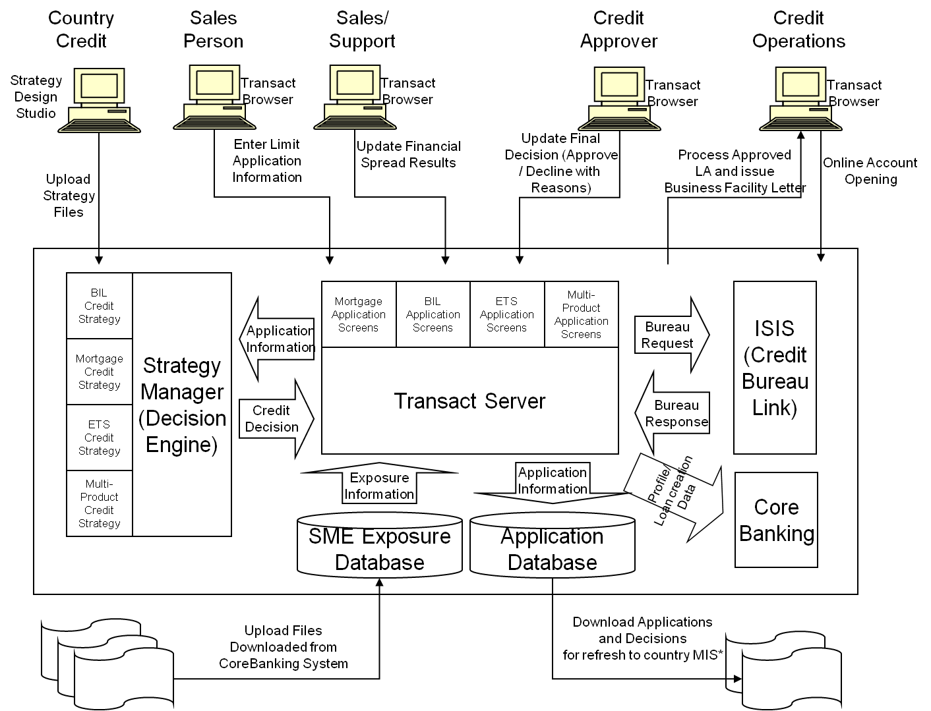
Transact Overall Architecture
Notes:
STP, eBBS/ICM, ICBS,
Product Groups, BIL/BOD(SG), BM/LAP
SCBEXtData, SCBSMEV5

Slide 5

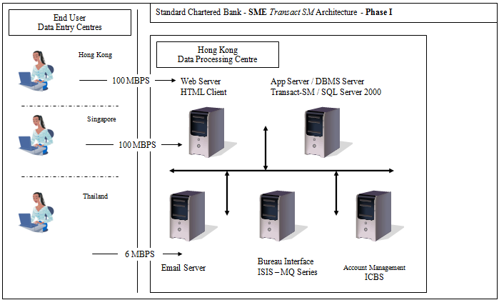

Slide 6
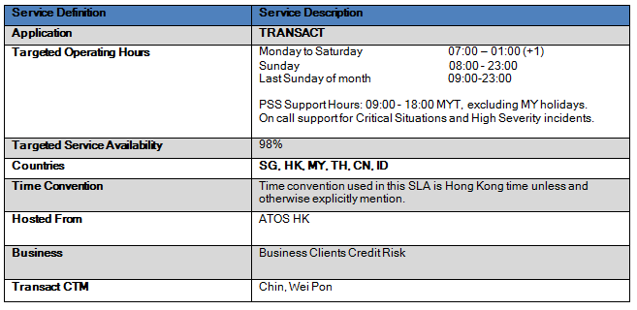
Production Details

Slide 7
Test Servers
IP Address | Extend | Lease End Date | Server Name | Platform / DB / MQ | CPU | Memory | Storage Size | Unit Cost(USD)
10.112.176.40 | 12 Months | Dec 30, 2016 | SMEDEV001 | W2K3 / MS SQL 2005 | 2 | 16 | 270 | $4,295.00
10.112.176.41 | 12 Months | Dec 30, 2016 | smedev002 | W2K3 | 4 | 4 | 150 | $2,257.00
10.112.176.88 | 12 Months | Jan 03, 2017 | mywltvud01 | W2K3 / MS SQL 2005 / MQ | 2 | 16 | 100 | $3,489.00
10.112.176.89 | 12 Months | Jan 03, 2017 | mywltvud02 | W2K3 | 2 | 8 | 100 | $2,020.00
10.112.176.72 | 12 Months | Dec 28, 2016 | smedev003 | W2K3 | 2 | 4 | 300 | $2,600.00

Slide 8
Transact Functions
Functions | Descriptions
Loan Application | Data entry/capture and processing of new business loan (BIL)
Renewals | Data entry/capture and processing of account renewals
Top-ups | Data entry/capture and processing of limit top-ups
Pre-screening | Provides pre-screening decision during initial stage of application
Sales Checklist | List document required for credit evaluation, timestamps upon document received
Credit Evaluation | For credit officer to assess the application based on document checklist, application, customer, related party, major buyer/supplier information
Credit Analysis | Performs blind check, call verification, credit summary, MA checklist, aggregate exposure check
Credit Bureau | Automated integration with country credit bureau on individual/consumer credit data via ISIS
Manual Credit Bureau | Data entry for manual credit bureau results
Credit Approving | For underwriter/credit approver to make final credit decision on application
Customer Acceptance | Allows input of customer response result (appeal, decline, accept) and fulfillment checklist
Fulfillment | Complete the document submission at the fulfillment stage of origination process and any appeal over interest rates; also linking of account numbers created to the application for tracking purposes
Loan Account Setup | Final account number implementation to complete the application
CASA Application | Process CASA deposit account application, document checklist, internal checklist, related parties
CASA Review and Approval | Check/Review completeness of data and documents for CASA application
CASA account setup | CASA account implementation
Workflow | Automate workflow throughout the loan life cycle from application till account setup in relevant TP
Application Query | Searches the database using Application Number, System Decision, Application Date, Business Registration Number, Customer Legal Name
Reporting | Provides operational reports directly from Transact database
Decision Making Agent | Core decision making component of Transact SM used by Pre-Screen Decision Call, Pre-Bureau Decision Call, Post-Bureau Decision Call, Credit Approver Decision Call
Transact Hook | Integrate Transact with SCB systems for blacklist check, CCPL reject and fraud check
Transact Lookup | Lookup Transact for pre-screen duplicate application check, credit evaluation duplicate check
Letter Production | Generates letter by country
Data Export | Produces a data file for TP account setup usage
Email Generation | Generates related email to Relationship Manager upon trigger of specified events
SMS Notification | Sends SMS to applicant
Parameter | Maintains operational parameters, used by system administrators

Slide 9
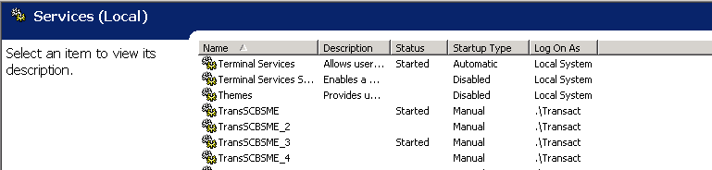
Transact Services

Slide 10
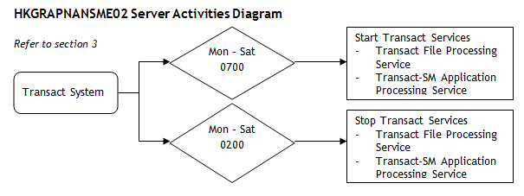
Server Activities

Slide 11
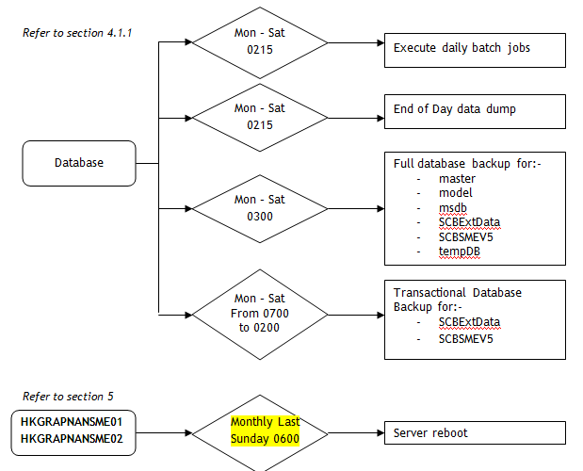
Server Activities

Slide 12
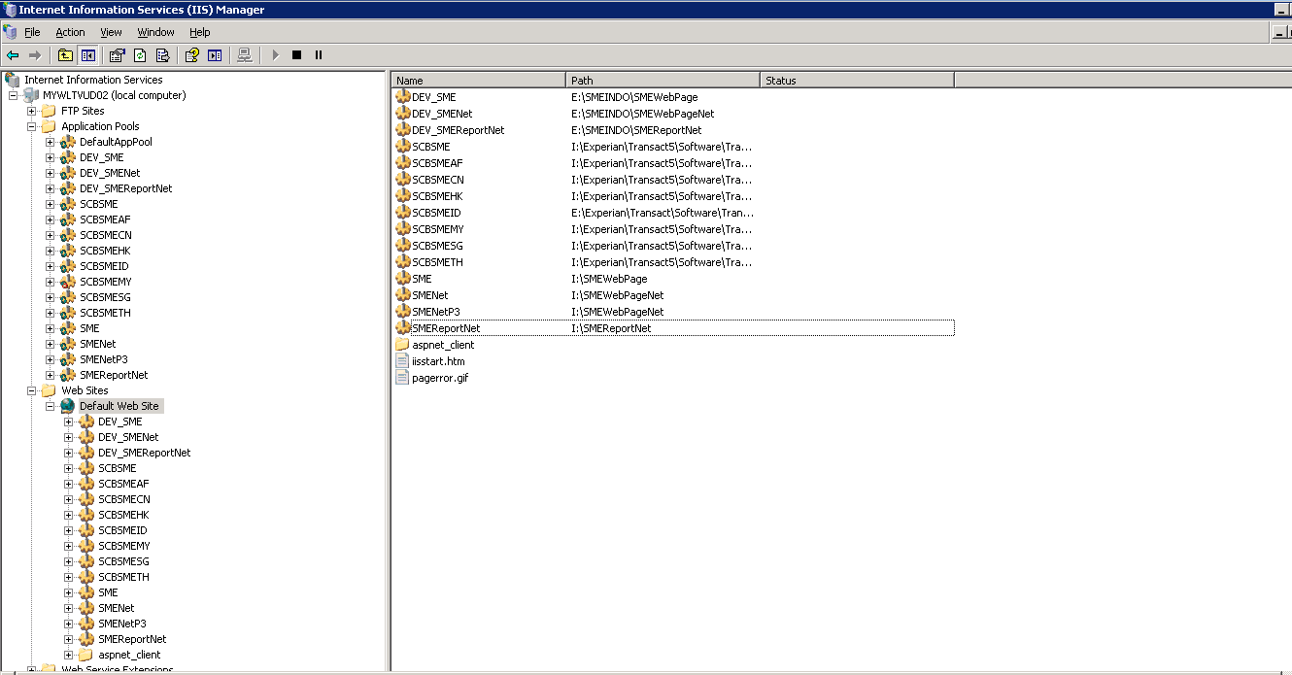
Transact Web Sites/Virtual Directories

Slide 13
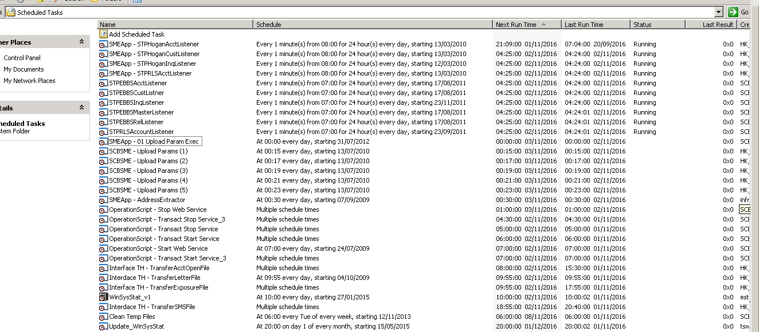
Scheduled Jobs in DB and APP Servers

Slide 14
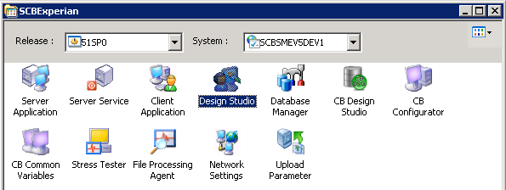
In-House/Vendor: Experian SDS Product

Slide 15
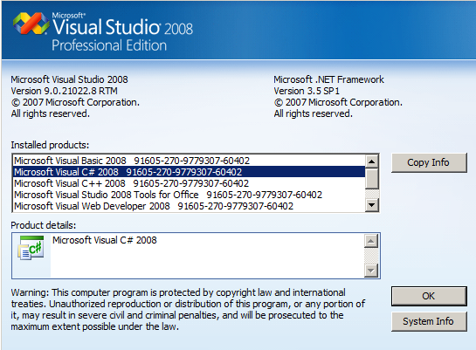
In-House Development

Slide 16
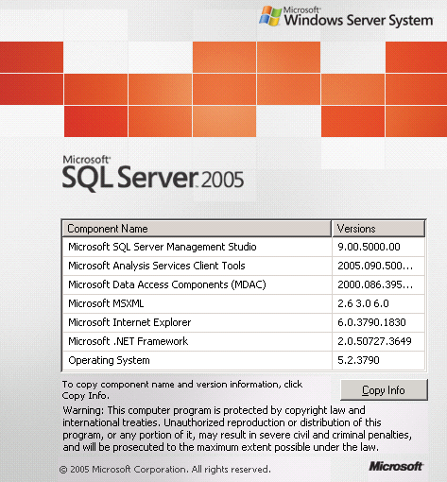
Database Server

Slide 17
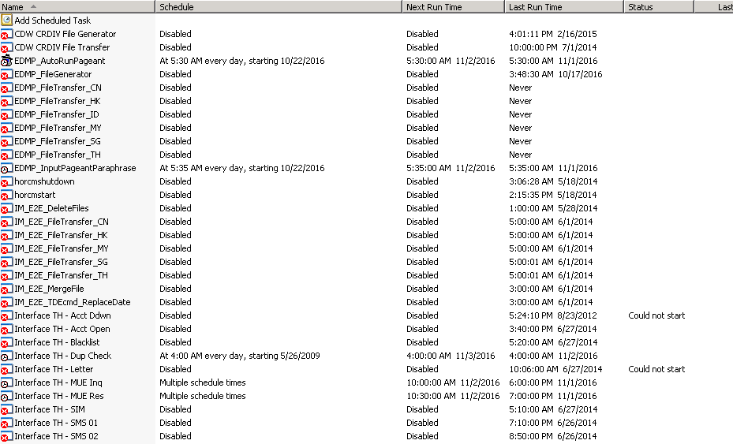
Server Jobs

Slide 18
Pre-requisition for security ID
Note: Raise below security ID via RMS upon completed respective e-learning courses
REMEDY 8.1
PIM Access Request (EAST): “ GBL-ISCM-SME” [Make sure Recipient is under assignment group member in Remedy]
Microsoft OCS Access ID Only: For communication with ATOS team regards Server, database, DR related issue/ activities
Clear Case ID Access
ClearCase FTP user ID required for the Bank ID
SCM access ID: For check in SM files to Production subversion (Staging), raise DOD and perform variance check
Access right to DA portal: For log ticket to Experian if there is any issue
Access right to Knowledge Management Portal
a.pss and o.pss access right

Slide 19
Transact Products
Product group list:
1. Business Installment Loan - SG, MY, HK,TH, CN, ID
2. Business Mortgage - SG, MY, CN
3. Business Overdraft - SG, HK, TH
4. Bundling - SG, HK, TH
5. Express Trade - SG
6. Loan Against Property - SG, CN, MY
Transact related contact list: 00 Transact Useful.doc
Transact BIL processes: Z:\A10. Project Related Documents\SME_Phase_2\12001833 Transact Indonesia\04 Architecture & Design\Transact ID FSD - BIL Workflow v1.doc
Transact 1st level support is GRD KL: http://10.128.234.30:8080/WIGIPSS/kedb/Login.jsp.
Transact Profile related issue is supported by GIS-GSA-MY-ASRM
Transact access/ password issue is supported by GIS-GSA-MY-ASIM
Transact Maintenance menu is handled by respective country champion.
Z:\A10. Project Related Documents\SME_Phase_2\12001833 Transact Indonesia\04 Architecture & Design\Transact ID FSD - Country Admin v1.doc

Slide 20
End

